Slide 1

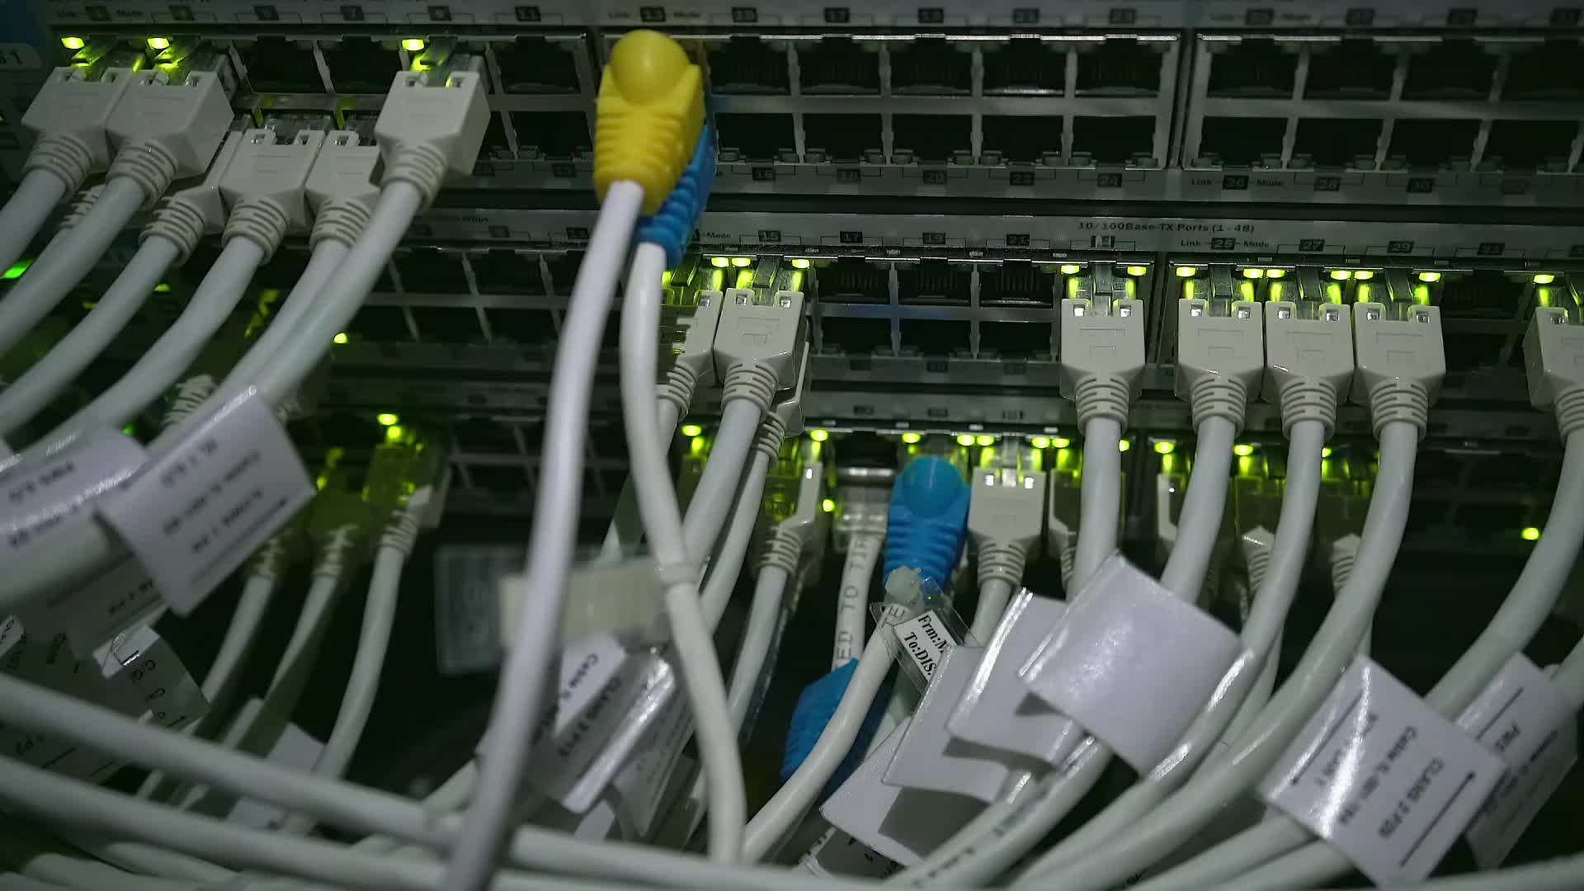


LAN Design, Implementation, and Configuration
Coursework Project Overview
Module Leader: Dr. Anar Abdelhady
TA: Aliaa Walid
TA. Dina Ayman

Slide 2
Assessment Schema
Individual Project | 40%
Unseen Exam | 60%

Slide 3

Introduction
What is a LAN?
A Local Area Network (LAN) connects computers within a small geographic area (e.g., office, school, home).
It allows for shared resources like files, printers, and internet access.
Project Overview
The project aims to help students understand how to design, implement, and configure a LAN.

Slide 4

Project Objectives
Key Goals
Understand Network Cable Installation: Compare the benefits and limitations of different networking media.
Assess Network Design: Evaluate current infrastructure and propose improvements.
Technical Research: Research and suggest technical solutions to networking challenges.
Cabling Best Practices: Learn about the best practices for cabling buildings and work areas.

Slide 5
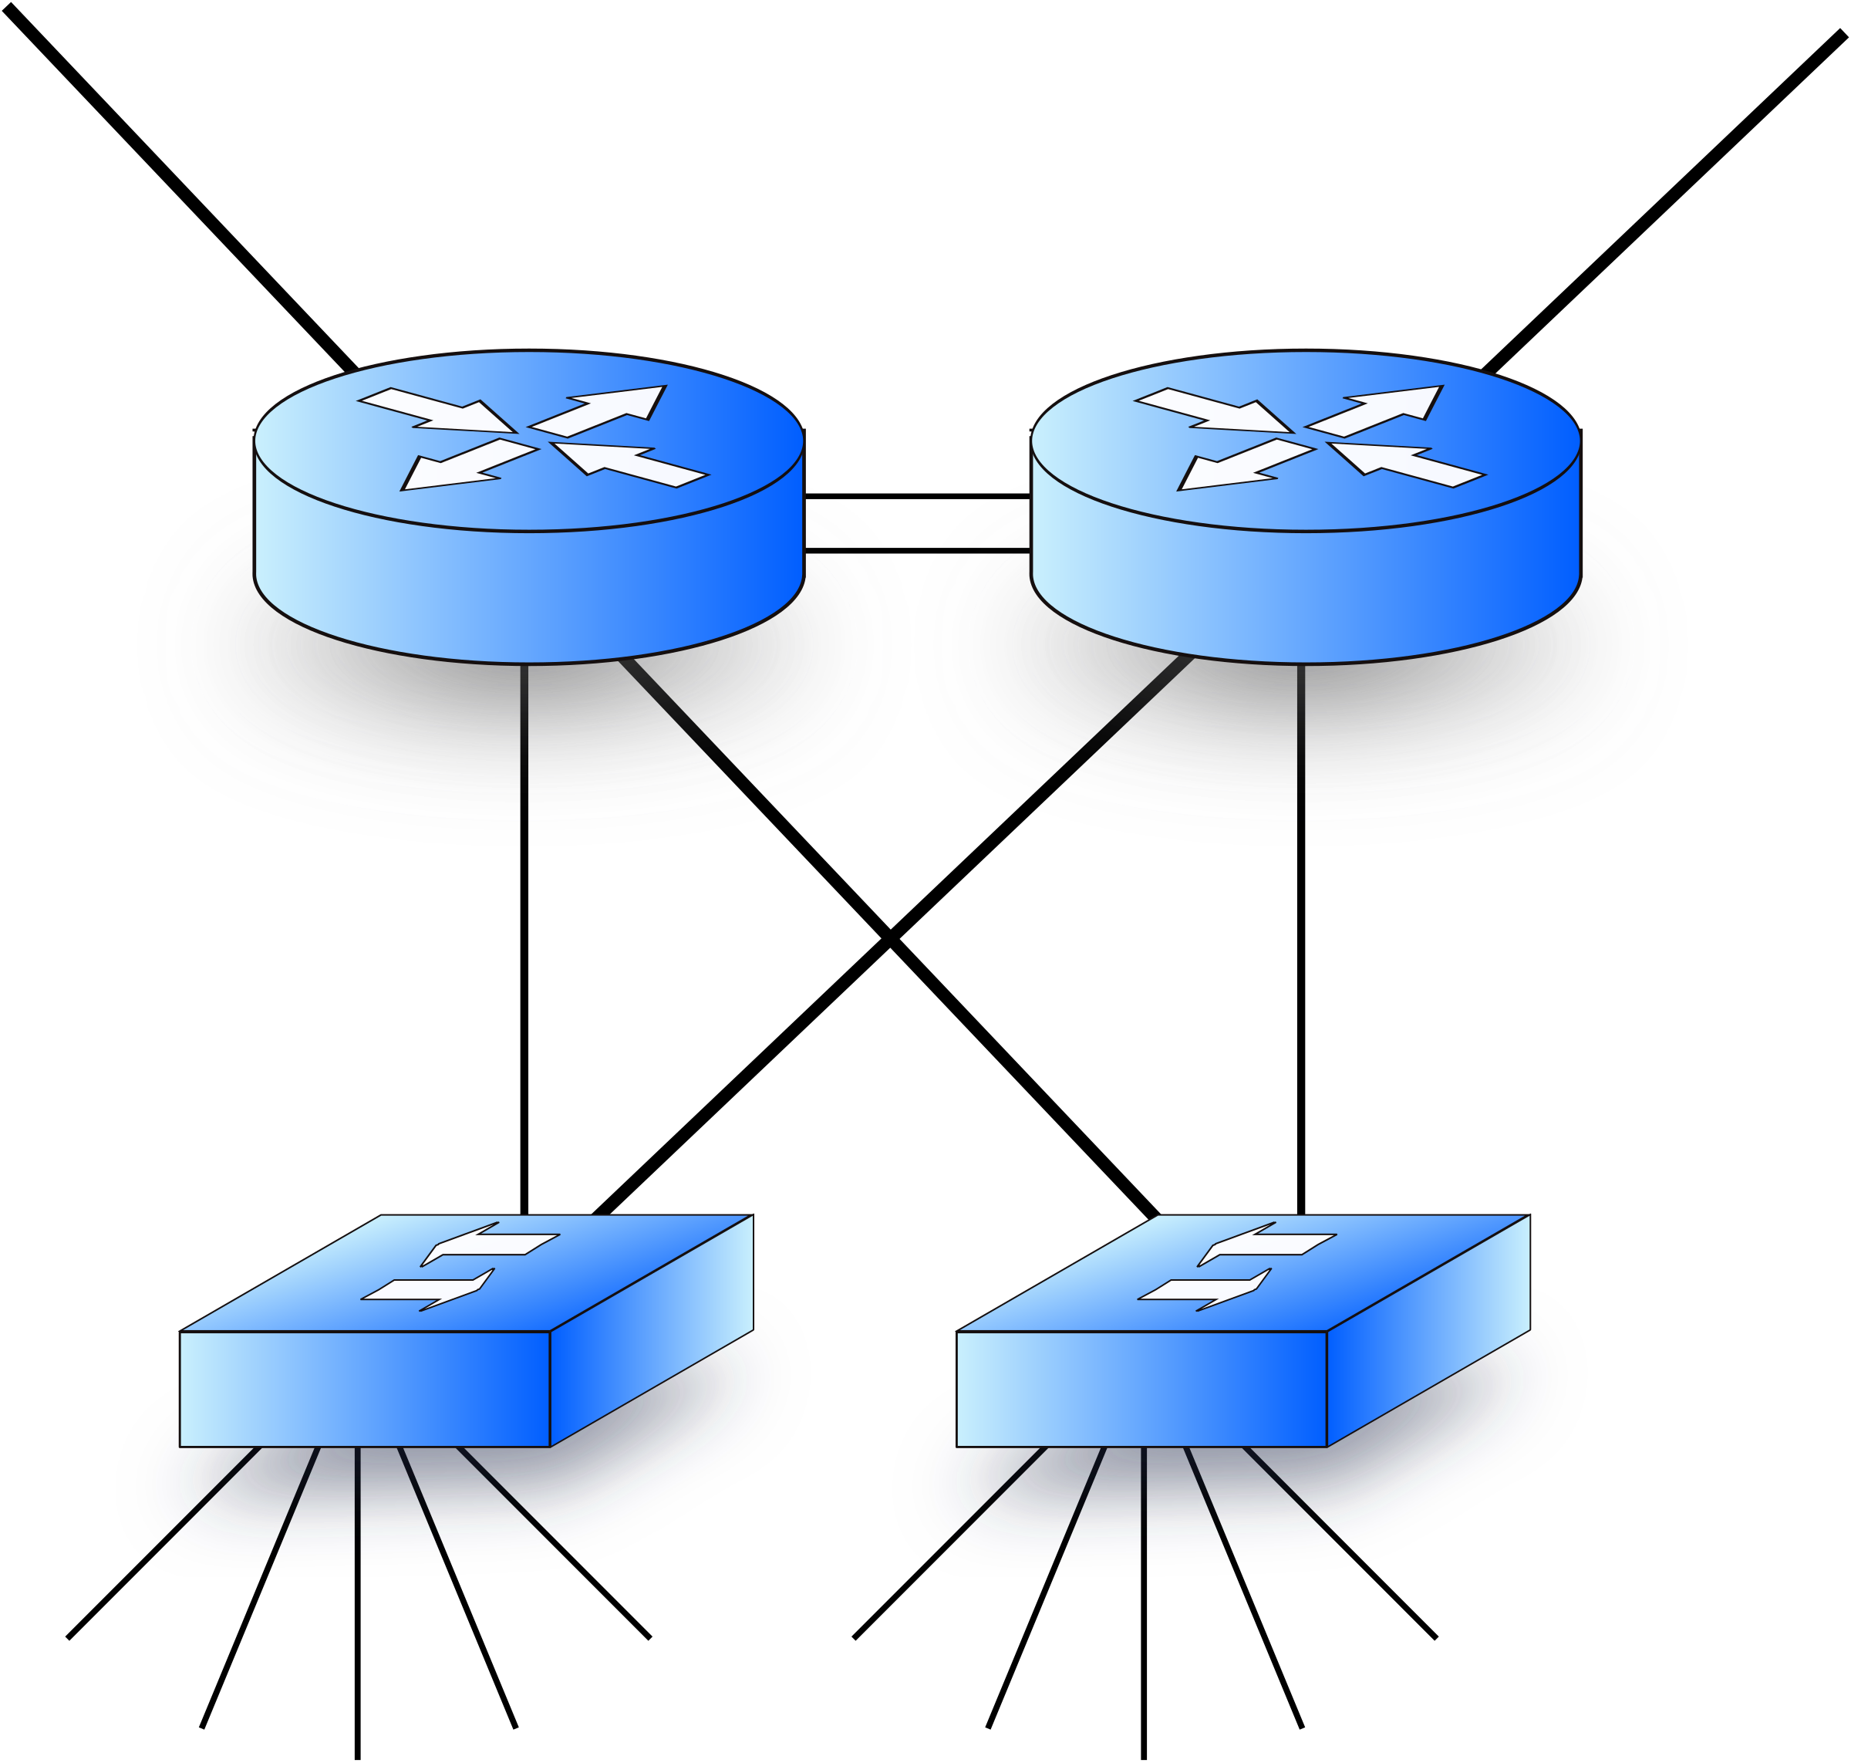
Project Scope
Students should select a project that fits within the scope of understanding LAN design, implementation, and configuration.
LAN Simulation Program: Use a networking simulator to simulate LAN performance.

Slide 6

Technical Requirements
Cisco Packet Tracer

Slide 7
Project Deliverables
Deliverables to Expect
Network Topology implementation
LAN Design Report: Details of the design, configurations, and testing process.
Simulation Results
Functionality testing & Verification

Slide 8
Deliverables Due
Date | Deliverable | Marks
Week 5 | Project Proposal | 10 Marks
Week 12 | Project Report + Code | 60 Marks
Week 12 | Discussion | 30 Marks

Slide 9
Project Phases
Project Proposal (10 Marks)
Project title
Abstract
Introduction
Scope of work and methodology.
Motivation & objectives.
Expected outcomes and deliverables.
Conclusion.
References (at least 2 papers).

Slide 10
Project milestones
Milestone 1 & 2: Project Delivery (Report + Implementation)
Detailed project description (Documenting all the work completed).
Technical specifications and methodology.
Implementation details.
Results (Sample runs), findings, and analysis.
Challenges encountered and solutions applied.
References.

Slide 11
Methodology and Approach
Steps to Follow
Research: Study the LAN technologies, networking protocols, and tools.
Design: Plan the LAN layout, choose the appropriate networking media, and design the cable infrastructure.
Implementation: Set up the LAN (simulated) and configure network devices.
Testing and Evaluation: Analyze the performance of the network, troubleshoot, and optimize where necessary.

Slide 12
Project Timeline
Research and initial planning.
Design phase.
Implementation and testing.
Final analysis, report writing, and submission.

Slide 13

Assessment Criteria
Check the Coursework Assessment Criteria uploaded on the E-Learning.

Slide 14
Submission policy
All milestone submissions must be done through the e-learning system.
You should follow the submission deadlines specified for each milestone.
Any student suspected of plagiarism, will be subject to the procedures set out in the GAR.
Students must attend discussion. If a student is absent, he will be considered absent for the: Discussion for final report and software and the Presentation and Demo deliverables.
Projects will not be accepted without submitting proposals before hand for approval.
Projects are subject to plagiarism checking through turnitin. Only a 20% of AI or references quoting is acceptable.

Slide 15
Conclusion and Next Steps
Summary
This project will provide hands-on experience with LANs.
You'll develop important skills in network design, simulation, and testing.
Make sure to follow the recommended project guidelines and timeline for success.
Next Steps
Choose your project type and get started on the research phase!

Slide 16


Thank You ☺
Any Questions?

